Slide 1
Creating Image of Portrait Style
in Joseon Dynasty Period Using CycleGAN
JONGWOOK-SI
Kumoh National Institute of Technology, Korea
Dept. Of Computer Engineering

Slide 2
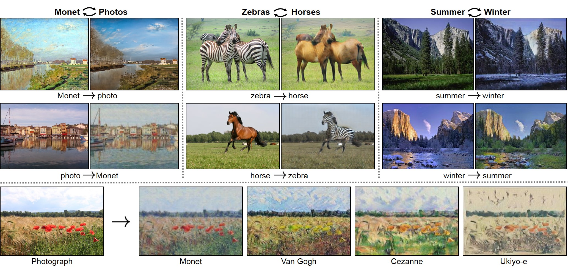
CycleGAN Introduction
What is CycleGAN?

Slide 3
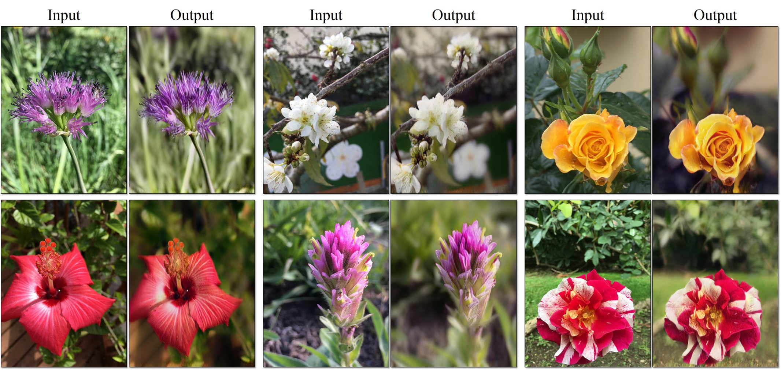
CycleGAN Introduction
What is CycleGAN?
The biggest shortcomings of CycleGAN is that it is difficult to change its shape

Slide 4
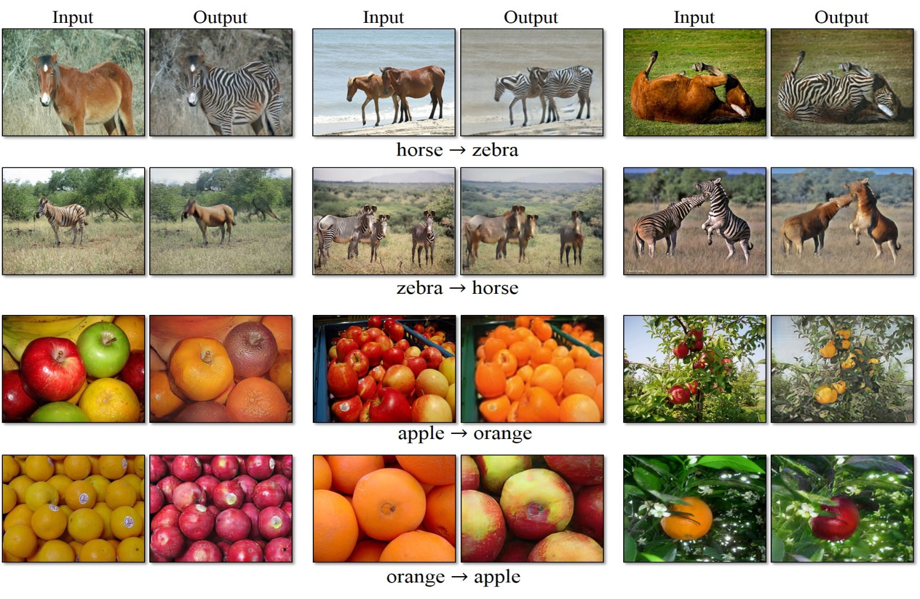
CycleGAN Introduction
What is CycleGAN?
The biggest shortcomings of CycleGAN is that it is difficult to change its shape

Slide 5
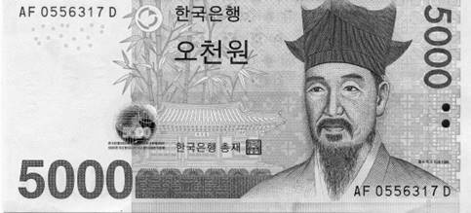
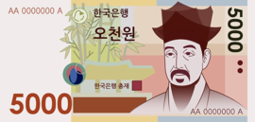
CycleGAN Introduction
GAN
X G(x)
G
D
Real? Fake?
D tries to distinguish fake.
G tries to deceive D with a fake image.

Slide 6
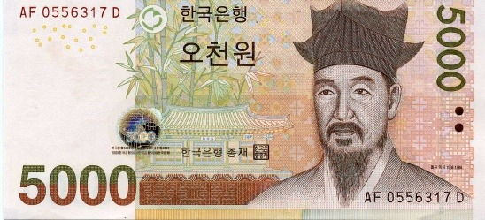
CycleGAN Introduction
GAN
X G(x) log(D(G(x)))
G
D
0.93 ☞ Fake
Y log(1-D(y))
D
0.01 ☞ Real
$argminmax E_{xy}[\log{D\left(G\left(x\right)\right)+log⁡(1−D\left(y\right))]}$ , GAN's strength is to make G and D a competitive relationship.
G D

Slide 7
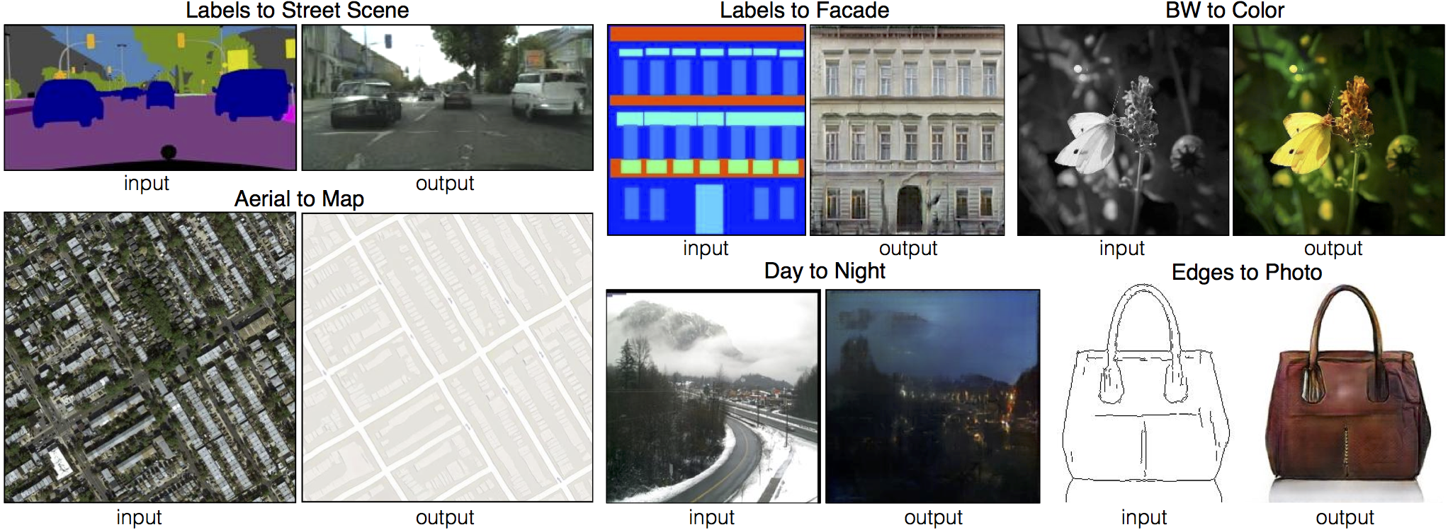
CycleGAN Introduction
Pix2Pix

Slide 8
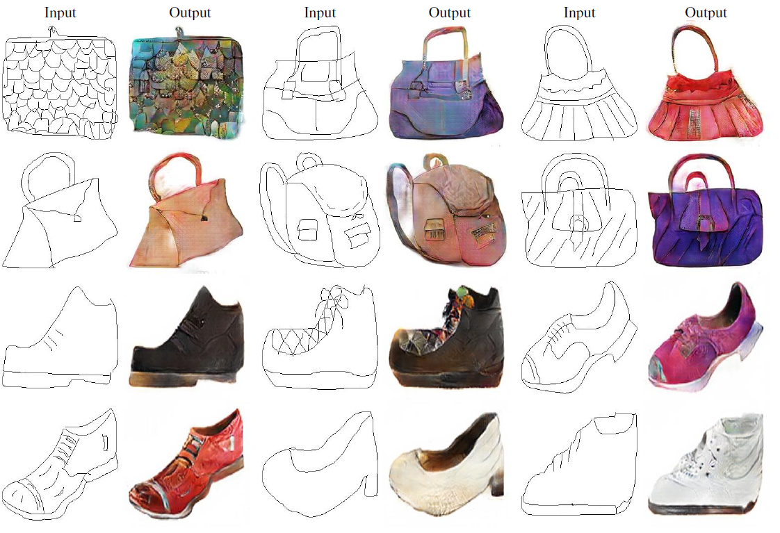
CycleGAN Introduction
Pix2Pix
Inputs and outputs must be paired (Supervised Learning)

Slide 9
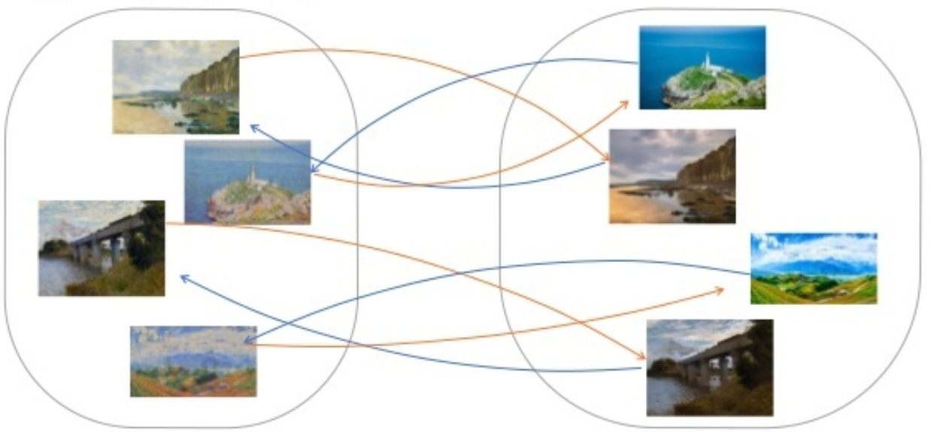
CycleGAN Introduction
CycleGAN
$$L_{GAN}\left(G\left(x\right),y\right)+{\left|\left|F\left(g\left(x\right)\right)−x\right|\right|}_{1} + L_{GAN}(F\left(y\right),x)+{\left|\left|G\left(F\left(y\right)\right)−y\right|\right|}_{1}$$

Slide 10
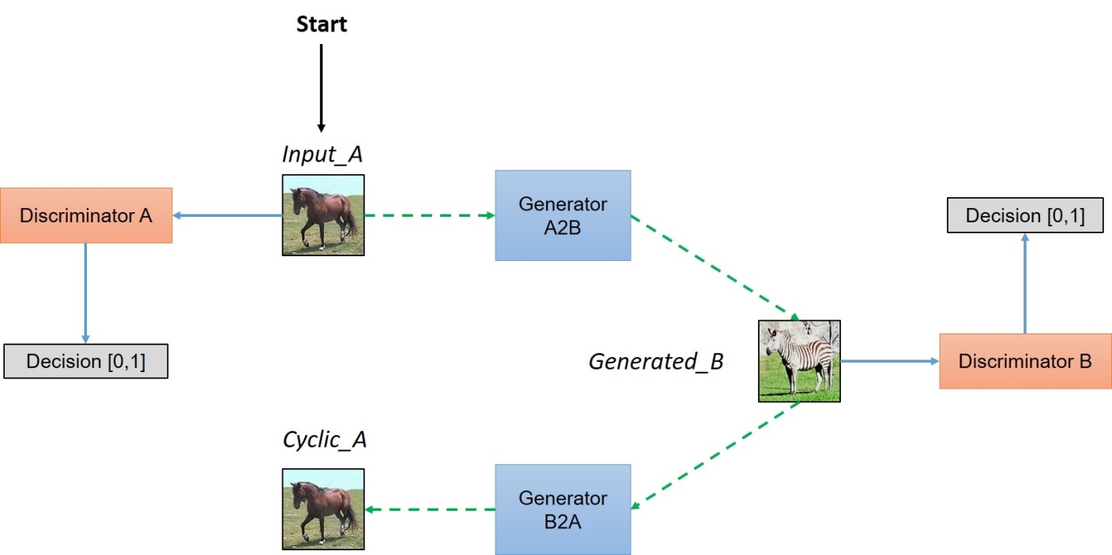
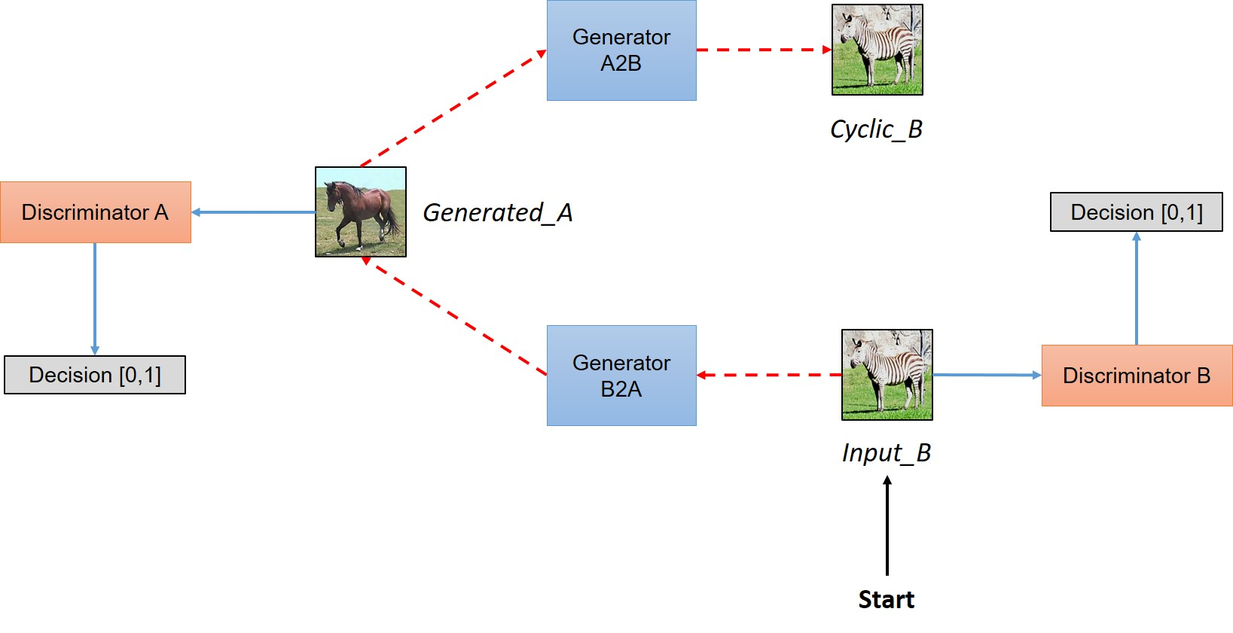
CycleGAN Introduction
CycleGAN

Slide 11
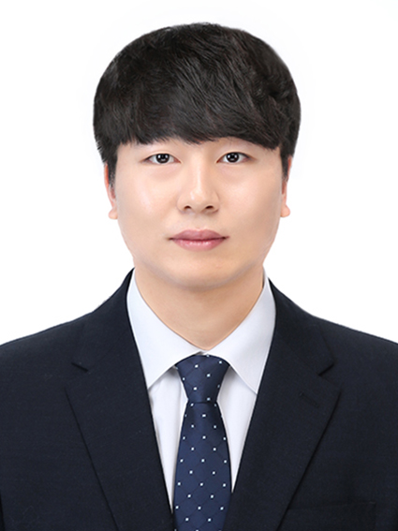
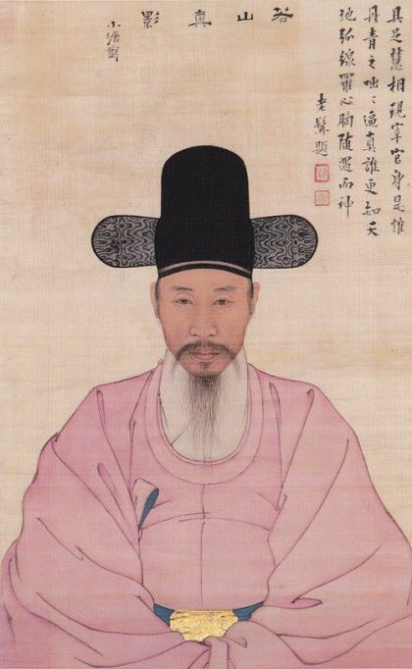
Idea Introduction
A B
Idea
Synthesis of objects in A and styles in B

Slide 12
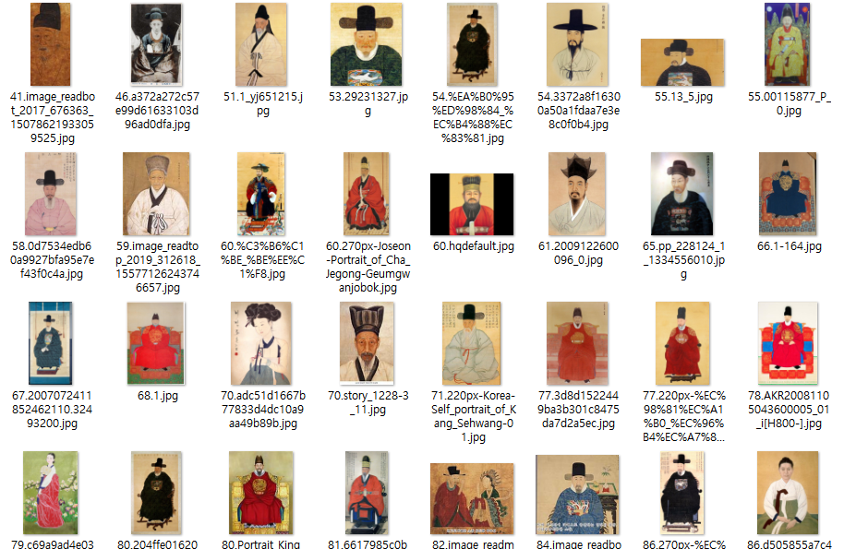
Idea Introduction
DataSet ( keywords = [“조선시대 초상화”, “한국 초상화”] )

Slide 13
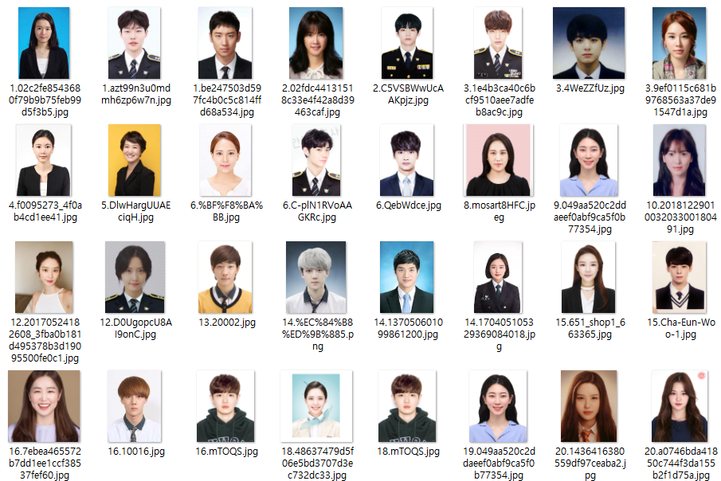
Idea Introduction
DataSet ( keywords = [“증명사진”, “취업사진”, “증사”] )

Slide 14
Idea Introduction
Environment
 | Contents
Operaing System | Ubuntu 18.04
GPU | TITAN Z
Python | 3.6.8
Tensorflow | 1.15.0
CUDA | 10.0

Slide 15
Idea Introduction
DataSet
 | A | B | SUM
Train | 326 | 312 | 638
Test | 44 | 49 | 91
Ratio | 88.11% | 82.46% | 85.74%

Slide 16
after 20hours …

Slide 17
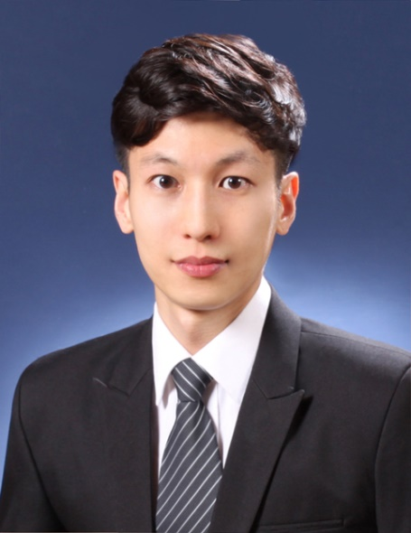
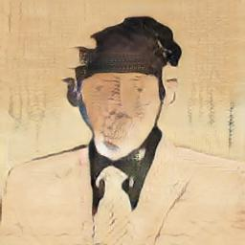
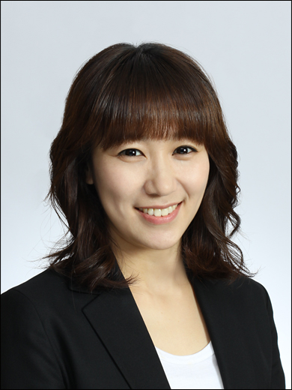
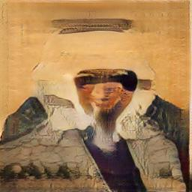
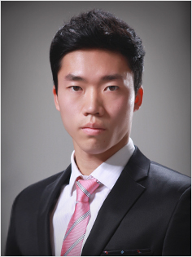
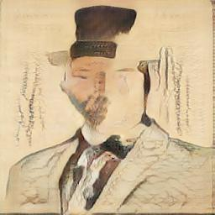

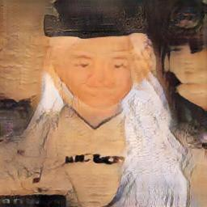
Idea Conclusion (AtoB)

Slide 18
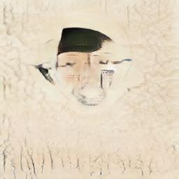
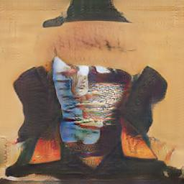
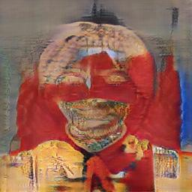
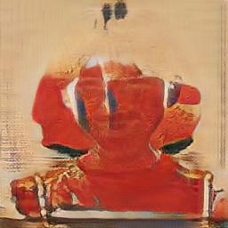
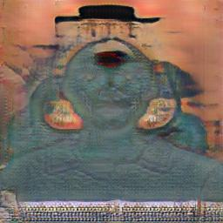
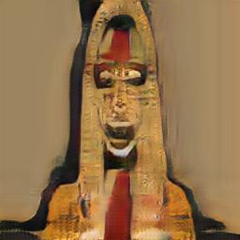
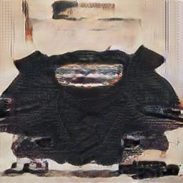
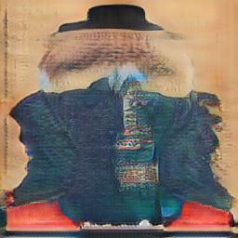
Idea Conclusion (AtoB)

Slide 19
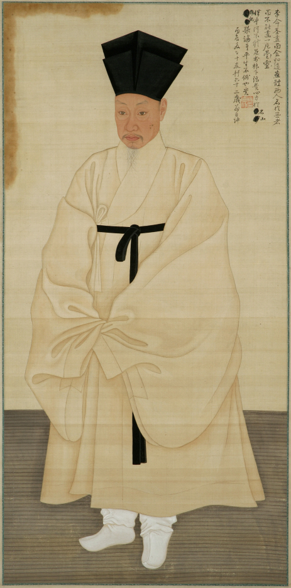
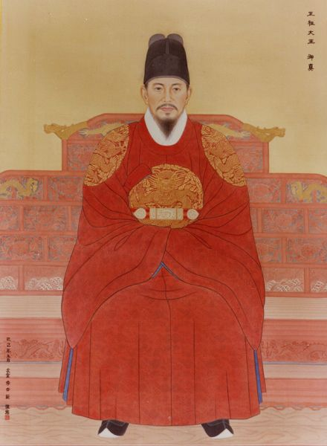
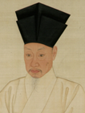
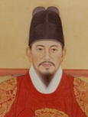
Idea Introduction
Analysis – B class’s data
The image will need to be preprocessed.

Slide 20
after 20hours …

Slide 21
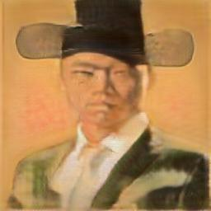
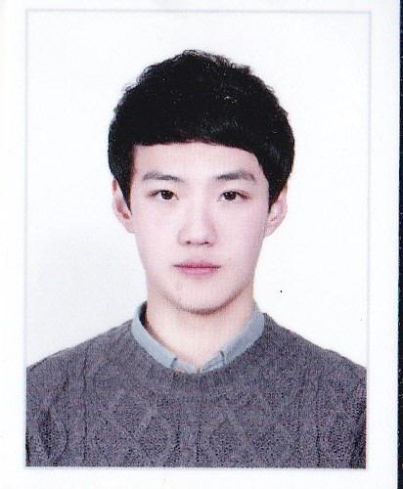
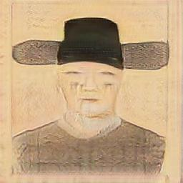

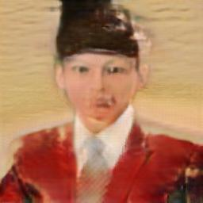
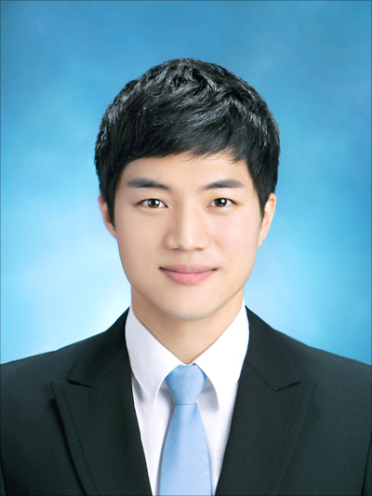
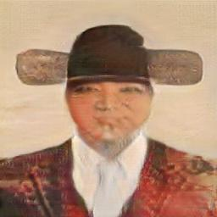
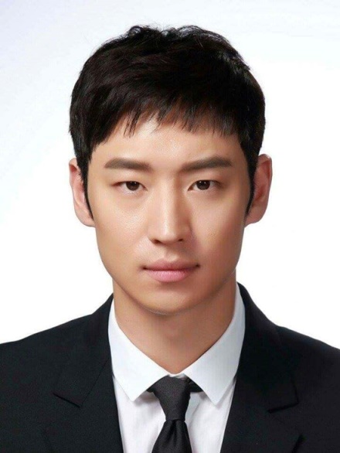
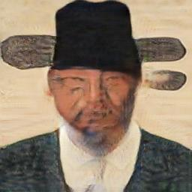
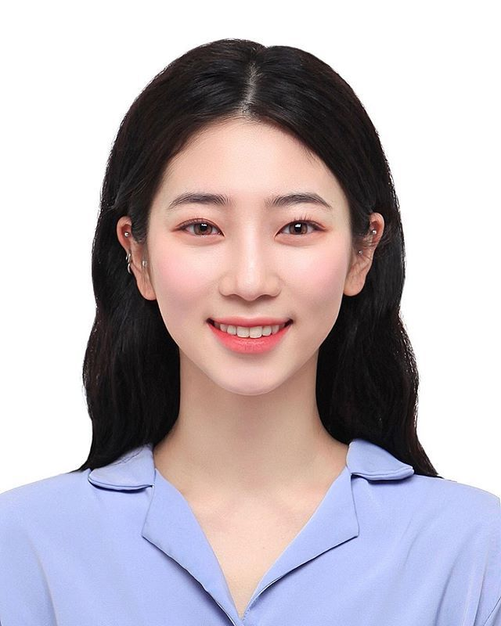
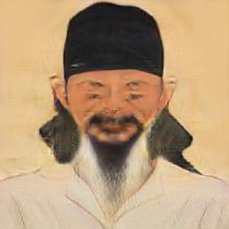
Idea Conclusion (AtoB)

Slide 22
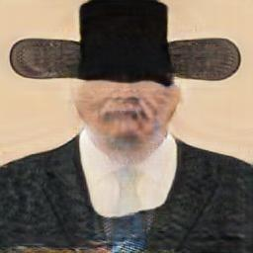
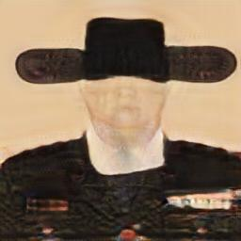
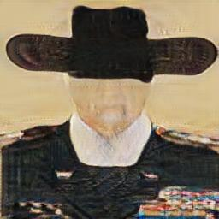
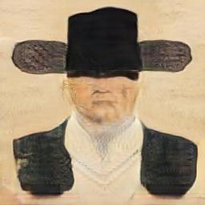
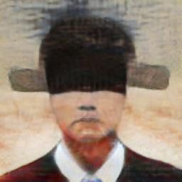
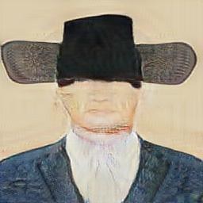


Idea Conclusion (AtoB)
The area of the eye was obscured by the hat.

Slide 23








Idea Conclusion (BtoA)

Slide 24
다음 슬라이드는 다소 보기 힘든 영상이 있으므로,
어린이, 임산부, 노약자 등 심신이 미약한 분은
잠시 화면을 꺼두시기 바랍니다.

Slide 25








Idea Conclusion (BtoA)

Slide 26
Idea Conclusion (AtoB)
Performance Improvement
1) Fix eye area covered by hat
2) The eyes, nose, and mouth are not clear.
3) Not enough data.

Slide 27
Analysis of Golf Swing Track
Using Correlation Matrix
JONGWOOK-SI
Kumoh National Institute of Technology, Korea
Dept. Of Computer Engineering

Slide 28

Introduction to Method

Slide 29

Introduction to Method

Slide 30


Introduction to Method
Covariance Matrix Correlation Matrix

Slide 31
Introduction to Method
원본군 x좌표 | 대조군 x좌표
[0]-Om | [0]-Cm
[1]-Om | [1]-Cm
[2]-Om | [2]-Cm
[3]-Om | [3]-Cm
… | …
[60]-Om | [60]-Cm
[61]-Om | [61]-Cm
Cov (원본,원본) | Cov (원본,대조)
Cov (원본,대조) | Cov (대조,대조)
Cor (원본,원본) = 1 | Cor (원본,대조)
Cor (원본,대조) | Cor (대조,대조) = 1

Slide 32
Introduction to Method
Cor (원본,원본) Matx[0] | Cor (원본,대조) Matx[1]
Cor (원본,대조) Matx[2] | Cor (대조,대조) Matx[3]
Cor (원본,원본) Maty[0] | Cor (원본,대조) Maty[1]
Cor (원본,대조) Maty[2] | Cor (대조,대조) Maty[3]
If ((Matx[1] < 0) && (Maty[1] < 0) )
corr_score = abs(Matx[1] - Maty[1]) / 2
Else
corr_score = abs(Matx[1] + Maty[1]) / 2

Slide 33
Introduction to Method
양의 선형관계
음의 선형관계
X, Y 비슷한 궤적 -> 둘 다 양의 선형관계
X, Y 궤적은 비슷하나 출발, 도착지가 다른 경우 -> 둘 다 음의 선형관계
X, Y 가 크로스인 경우 -> 양의 선형관계와 음의 선형관계

Slide 34


Introduction to Method
Source Code

Slide 35


Introduction to Method
Source Code

Slide 36

Introduction to Method
Source Code

Slide 37


Conclusion

Slide 38





Conclusion

Slide 39

THE END

